Slide 1
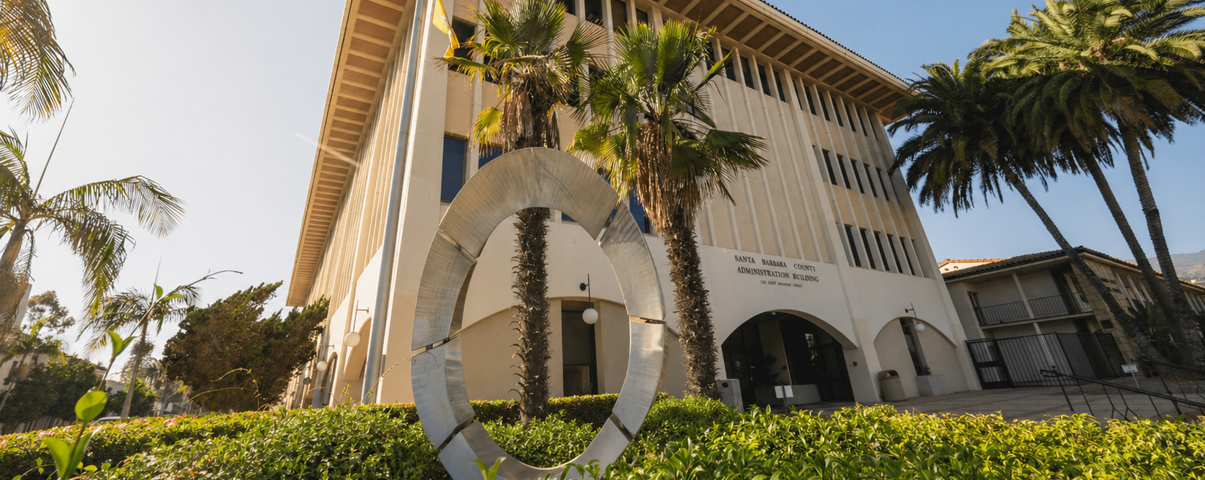
COUNTY OF SANTA BARBARA
OFFICE OF THE AUDITOR-CONTROLLER
Treasurer-Tax Collector
Tax Redemption Officer Audit
July 1, 2020 – June 30, 2023
Betsy M. Schaffer, CPA, CFE, CPFO Auditor-Controller
June 23, 2026

Slide 2
Background
California Revenue and Taxation Codes (RTC) §4108.5 states the Auditor-Controller shall audit the records and accounts of the Tax Redemption Officer at least once every three years. The prior audit was completed for two three-year periods encompassing July 1, 2014 through June 30, 2020 and was presented to the Board on February 1, 2022.
This audit was performed to evaluate compliance with California RTC as they relate to the Tax Redemption Officer’s responsibilities in the collections of delinquent property taxes owed to the County from taxpayers.
This audit was included as a mandatory project/engagement in the fiscal year 2025-2026 Internal Audit Plan.
Applicable RTC sections outline strict guidance over the Tax Redemption process and require absolute adherence to ensure the County continues to recognize property tax revenue accurately and completely.

Slide 3
Executive Summary
Audit objectives included:
Verifying compliance with applicable RTC sections via substantive testing at various stages of the redemption process.
Evaluating the adequacy of internal guidance that outlines relevant procedures.
Observations:
Proactive redemption outreach practices.
Lack of documentation related to internal departmental processes and procedures.

Slide 4
Audit Results
Internal Audit was able to provide reasonable assurance that the Treasurer-Tax Collector (TTC) complied with applicable RTC requirements.
Internal Audit identified two observations and listed recommendations for Department management to consider.
Internal Audit will conduct the next engagement for the period July 1, 2023 – June 30, 2026.

Slide 5
Audit Results (continued)
1) Proactive redemption outreach practices
TTC performs outreach beyond the minimum statutory notice and collection requirements.
The office exhausts all available avenues to reach and assist taxpayers before property advances further into tax-defaulted status.
2) Lack of documentation related to internal departmental processes and procedures
The Department appears to have developed practices over time based on experience but has not yet consolidated those practices into a formal procedure manual.

Slide 6
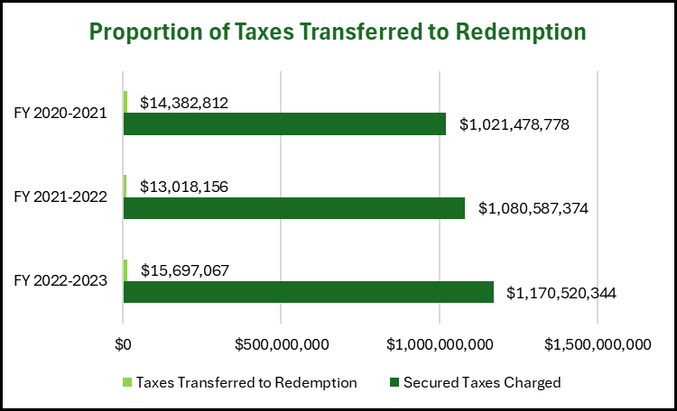
Analytics
Of the total $3,272,586,496 in secured property taxes charged during 7/1/20 – 6/30/23, $43,098,035 (1.32%) was declared tax-defaulted and transferred to redemption status.

Slide 7
Analytics (continued)
During the audit period, there were a total of 5,247 unique parcels with delinquent tax bills that were transferred to the redemption roll.
That amount comprised of:
-3,973 residential parcels, and
-1,274 commercial parcels

